Slide 1
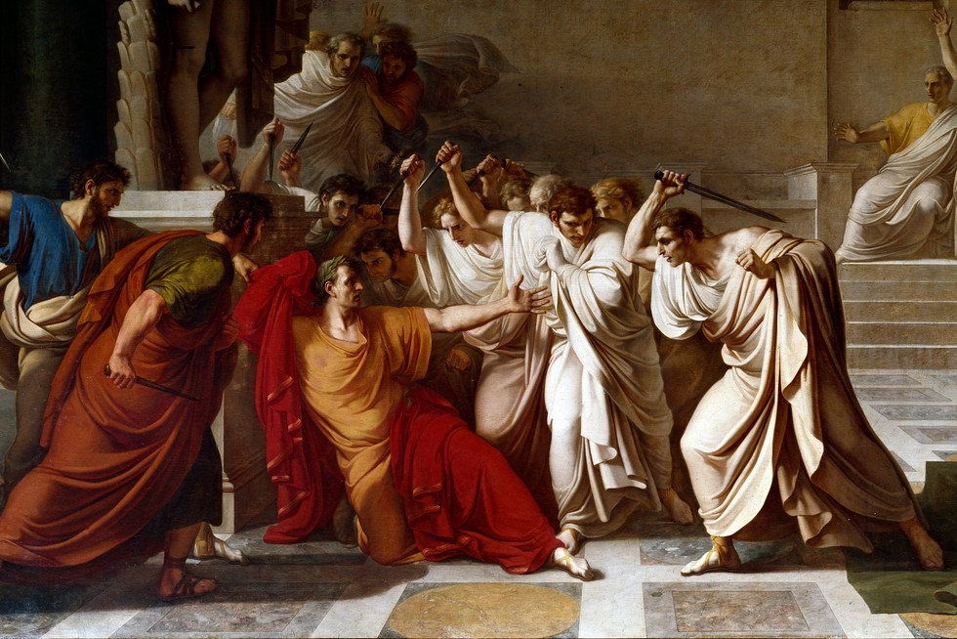
Rome – Cultural Structures
GOAL/S: Identify and describe Roman Cultural Structures
Week 2, Lesson 2

Slide 2

INSTRUCTIONS:
Read through the 4 information sheets provided. Summarise the information in your book.
Complete the questions from the following pages:
Pg. 303 – Q 1 – 2
Pg. 305 – Q 1 – 4
Pg. 307 – Q 1 – 3
Pg. 309 – Q 1 - 3

